Slide 1
Vidhu Jha | 19MT10048
Bachelor in Technology | Metallurgical and Materials Engineering
Prediction of overall sentiment and engagement of social media posts with respect to Electric Vehicles
Prof. Swagato Chatterjee
Vinod Gupta School of Management (VGSoM)
Indian Institute of Technology Kharagpur

Slide 2

Motivation
Problem
Electric Vehicles (EVs) are a rapidly growing component of the automotive industry.
However, it is almost impossible to create exact predictions about the EV industry. We want to probe the overall sentiment regarding EVs, and predict the engagement of social media posts with respect to them.
Solution
We use a token-wise and document-wise sentiment analysis using both unsupervised and supervised models applied to data set scraped from Facebook.
At last we perform an exploratory visualization of sentiment and topics news media and consumers frequently discuss.
Notes:
In efficient markets, financial prices should display a random walk pattern. More precisely, prices are assumed to follow a Markov process, which is a particular stochastic process independent of its history — the entire distribution of the future price relies on the current price only. The past is irrelevant.

Slide 3
Prerequisites
Latent Dirichlet allocation (LDA) is performed to infer the various topics of electric vehicles as it provides a better insight into topics, as well as better accuracy than others possible methods
Topic Modelling
Technique for uncovering a corpus' hidden semantic structure and gaining insight into the various themes contained in the texts
Sentiment Analysis
The analysis is done on a total of 3,00,000 Facebook posts from a variety of Facebook pages, over a wide period of time, and on different topics of electric vehicles
Natural Language Processing (NLP) based technique used to determine whether data is positive, negative or neutral
Notes:
In efficient markets, financial prices should display a random walk pattern. More precisely, prices are assumed to follow a Markov process, which is a particular stochastic process independent of its history — the entire distribution of the future price relies on the current price only. The past is irrelevant.

Slide 4
Literature Review:
Pre Processing
Feature Extraction
Remove all Stop Words, URLs , hashtags, tags, punctuations, symbols, and numbers.
Correct the spellings, expand Acronyms
Replace all the emoticons with their sentiment.
Words and Their Frequencies: Unigrams, bigrams, and n-gram models.
Parts of Speech Tags, Opinion Words and Phrases Apart from specific words.
Negation to understand the polarity of the opinion.
Syntax Syntactic patterns like collocations are used as features to learn subjectivity patterns.
Natural Language Toolkit (NLTK) : Python package that includes several tools for data classification and programming with a collection of text processing packages for classification, tokenization, stemming, tagging, parsing, and reasoning.

Slide 5
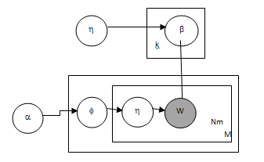
Literature Review:
Latent Dirichlet Allocation (LDA)
For each topic, j, βj is sampled.
For each document, m, θm is sampled.
For each word position n in document m , a topic z from the categorical distribution parameterized by θm.
Finally, a parameterized word from the categorical distribution by βz.
Valence Aware Dictionary and Entiment Reasoner (VADER) : A sentiment analysis tool that has a lexicon and rules tailored for the sentiment broadcast on social media.
The generative process of LDA

Slide 6
OBJECTIVES
To analyze how electric vehicles and related topics are being perceived sentimentally in social media. We will perform LDA on the Facebook data of electric vehicles to collect the top 20 words. Understanding user sentiments to implement VADER and SONAR sentiment analysis models.
The main objective of this project includes:
● Exploratory data analysis of posts, user location, and keywords.
● Development of the topic model to identify the key topics.
● Visualization of different topics from the electric vehicle tweets.
● Result of sentiment analysis to identify positive, negative, and neutral posts.

Slide 7
About the Dataset
Key Columns | Description
Page Name | Name of the page from where the text is taken
User Name | User Name of the user who wrote the text
Facebook Id | Facebook id of the user who wrote the text
Page Category | The category of the page from where the text is taken
Page Admin Top Country | The country of the admin of the page from where the text is taken
Page Description | The given description of the page

Slide 8
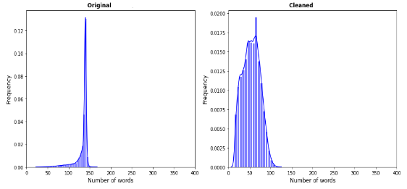
Effect of preprocessing the dataset

Slide 9
Pre-processing schemes
Tokenization
Segmentation already happens in English, and tokenization is implicit. Because a space separates each word, it can make the token by dividing the text on each space.
POS Tag Detection
For data analysis, a part of speech could be helpful in two ways. For instance, one can use it to clarify a word's meaning. The second application of POS tags is classifying terms and processing them differently, depending on which kind they belong.
Lemmatization
When processing samples, “word” and “words” would be considered as two different features. Hence, to improve the features reduction process, the unigrams can be lemmatized. This pre-processing step mainly allows removing plurals and conjugations.

Slide 10
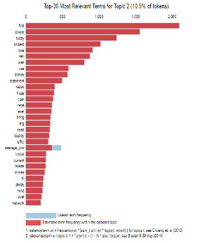
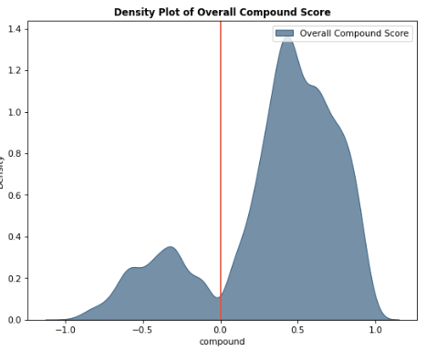
Visualization of LDA and VADER models
Interactive Topic modelling visualization (LDA)
Density plot of Overall VADER compound score

Slide 11
Discussion
ANALYZING NEGATIVE SENTIMENTS
Elon-musk is the common bi-gram found in the tweets related to electric vehicles. 47.1% of tweets are positive, 42.4% are neutral, and 10.5% are negative as per VADER. SONAR identified critical tweets which were hateful and offensive. These tweets happened during tesla declared non acceptance of bit coin for the purchase of electric vehicles. For further analysis VADER and SONAR sentiment analysis models were built
LIMITATIONS OF LDA AND VADER
Latent Dirichlet allocation models cannot identify Correlation, Static cannot topics identify over change in time, VADER is not accurate for complex data, does not recognize context, required additional visualization output to understand the results.

Slide 12
Conclusion
Inference
According to social media discussion concerning electric vehicles, there is a growing sentiment of trust and positive sentiment indicating that electric vehicles will be more widely accepted in the near future.
My Contribution
My crucial contribution in this project is to implement topic modeling to identify key topics, visualization using LDA, bi-grams, word cloud,
dominant topics, VADER sentiment, and SONAR which will help in the future sentiment towards electric vehicles in India.

Slide 13
Future Work
For the future scope, I continue to work on dynamic topic modeling concerning time and introduce multiple NLP classifiers to understand the accuracy of sentiment predicted along with VADER and SONAR.

Slide 14
Thank you!
We are open to any questions

